Slide 1

Presentation title
Presenter name

Slide 2

Problem Definition
The primary goal is to develop a machine learning model that can accurately predict customer churn, allowing ConnectTel to identify at-risk customers and take action to prevent churn. This solution is expected to enhance customer retention, protect revenue, and increase overall customer satisfaction.

Slide 3
Exploratory Data Analysis (EDA)
A thorough exploratory data analysis was performed to
gain insights into the data and understand relationships
between the features and churn.
The key analyses included:
Univariate Analysis
Examined the distribution of individual features such as Tenure, Monthly Charges, and Contract.
Bivariate Analysis
Analyzed the relationships between Churn and specific features, identifying trends (e.g., month-to-month contracts had higher churn rates).
Multivariate Analysis Explored interactions between multiple features, such as Internet Service and Tech Support, to understand complex patterns.

Slide 4
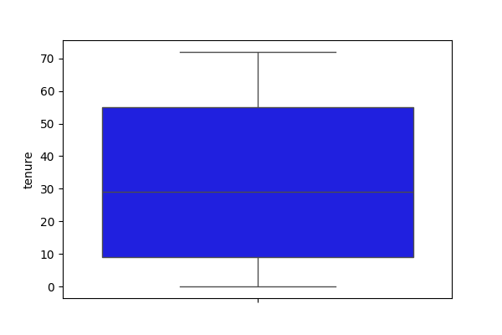
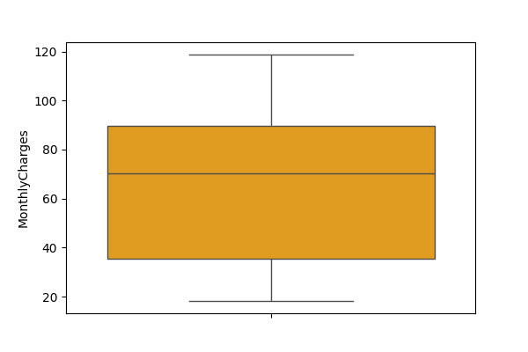
Univariate Analysis of tenure and monthly charges

Slide 5
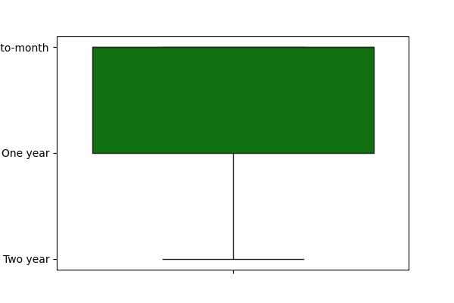
Univariate Analysis of contract type

Slide 6
Key Findings from Univariate Analysis
Customers with shorter tenures were more likely to churn.
Churn rates were higher among customers with month-to-month contracts.
Specific services, such as a lack of online security, were associated with higher churn rates.

Slide 7

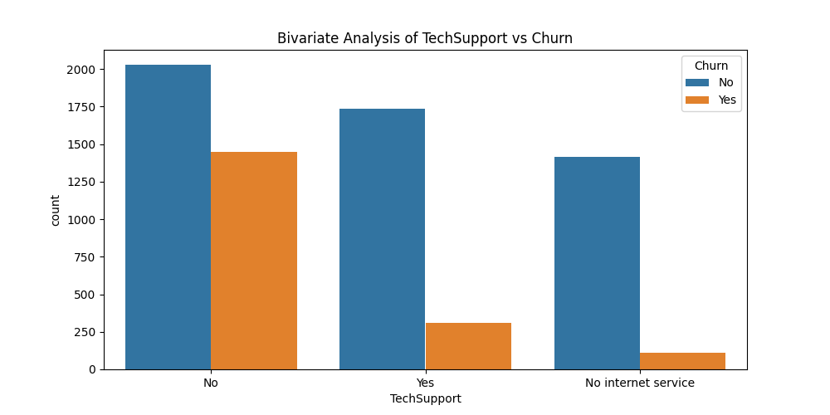
Bivariate Analysis
This plot shows that majority of the customers with tech support did not churn.
Customers without tech support are more likely to churn while customers with no internet services has very low chances of churning.

Slide 8
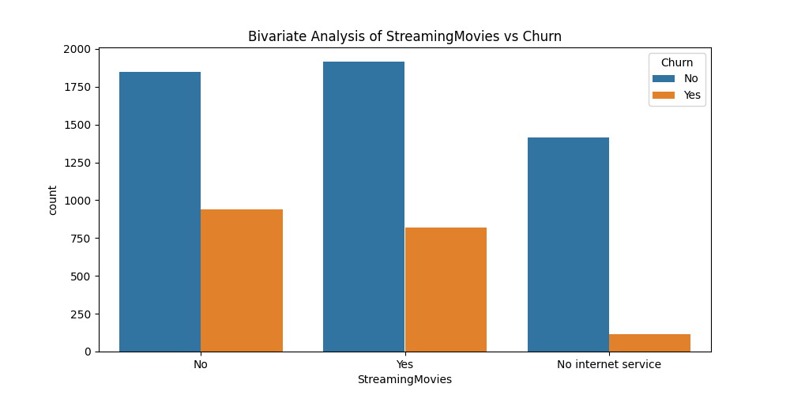
This plot shows that significant number of customers whether streaming movies or not does not churn.

Slide 9
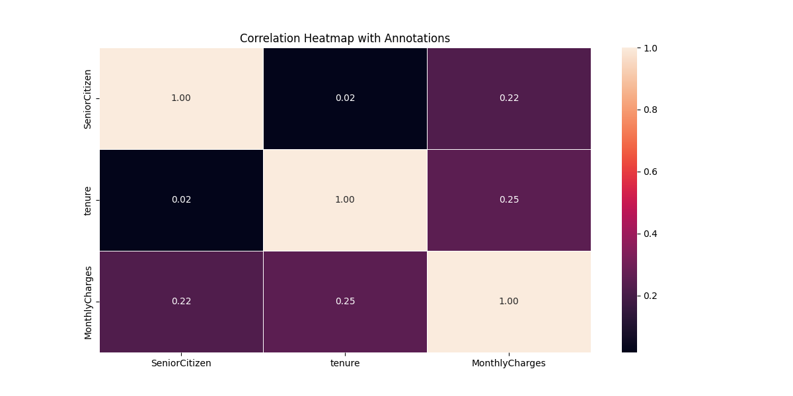
The diagonal element shows a perfect correlation. None of the features has very strong positive or negative relationships as most values are relatively close to 0.
Most of the features are largely independent of one another.

Slide 10
Feature Engineering
To enhance model performance, several feature engineering techniques were applied:
Encoding Categorical Variables: Categorical features were converted into numerical values using techniques.
New Feature Creation: Based on insights from the EDA, new features were created.
Scaling Numerical Features: Features such as Tenure, MonthlyCharges, and TotalCharges were scaled using MinMaxScaler to normalize their ranges.

Slide 11
Model Selection, Training, and Validation
Three different supervised learning models were selected, trained, and validated to predict customer churn
Logistic Regression
A model that provided initial insights into feature importance.
Decision Tree Classifier
A non-linear model that helped capture complex patterns in the data.
Random Forest Classifier
An ensemble method chosen for its robustness and higher accuracy.

Slide 12
Model Evaluation
Models | Logistic Regression | Decision Tree Classifier | Random Forest Classifier (Best Model)
Precision | 0.48% | 0.47% | 0.67%
Recall | 0.86% | 0.47% | 0.46%
F1-Score | 0.62% | 0.47% | 0.54%

Slide 13
False Negatives vs True Positives
To reduce customer churn effectively, the business should prioritize minimizing false negatives (i.e., missed churn cases).
False Negatives (Missed Churn Cases): A false negative means a customer who is at high risk of churning was predicted to stay. This is critical because these customers, who may soon stop their services, represent missed opportunities for retention efforts. Minimizing false negatives helps the business catch at-risk customers early and take proactive measures.
True Positives (Correctly Predicted Churns): While high true positives are also essential, they are generally less costly than missing at-risk customers. Increasing true positives ensures that retention efforts focus on likely churners, but a high recall (which minimizes false negatives) is generally more impactful.

Slide 14
Recommendations Based on Model Insights
1. Targeted Retention Programs
The business should focus on customers with month-to-month contracts, as they have a higher likelihood of churning. They can offer incentives to customers with high monthly charges to increase their loyalty, such as discounts or loyalty rewards.
2. Service Improvement Initiatives
The business should focus on customers without additional services like online security or tech support showed a higher tendency to churn. The business can offer bundled service packages or adding-on incentives may help retain these customers.
3. Personalized Customer Outreach
The business should use the model predictions to identify at-risk customers and engage them with personalized offers or communications, focusing on enhancing customer experience.
4. Continuous Model Monitoring and Updating
The business should monitor model performance over time and periodically retrain the model with new customer data to maintain its accuracy and reliability.

Slide 15


Conclusion
The Customer Churn Prediction Model enables ConnectTel to proactively address customer churn by identifying at-risk customers and implementing targeted retention strategies. This data-driven approach is expected to improve customer satisfaction, reduce revenue losses from churn, and maintain ConnectTel’s competitive edge in the market.

